Slide 1
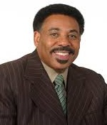
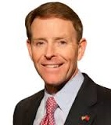
Mid-Atlantic Men’s Conference
Saturday November 7, 2015 – 8:30 am – 3:00 pm
McLean Bible Church
Special Guest Speakers: ► Jeff Kemp, former NFL QB ► Don Davis, former NFL DB
PLUS eight breakout sessions, panel discussions, interviews and the Iron Men Praise Band
Dr. Tony Evans Pastor, Oak Cliff Bible Church, Dallas
Tony Perkins Pres., Family Research Council, DC
Information and Registration – www.wacmm.org

